Slide 1

iGEM Introduction and Molecular
Biology Lab
Speaker: Feng-Yu, Wang Department of Life Science, NTHU 2018/08/09

Slide 2
Outline
Introduction
Brief introduce synthetic biology and iGEM.
Introduction of our project.
Molecular biology lab
Introduction of pipette.
Introduction of cloning.
Plasmid extraction
Transformation
Colony PCR and electrophoresis

Slide 3
Outline
Introduction
Brief introduce synthetic biology and iGEM.
Introduction of our project.
Molecular biology lab
Introduction of pipette.
Introduction of cloning.
Plasmid extraction
Transformation
Colony PCR and electrophoresis

Slide 4
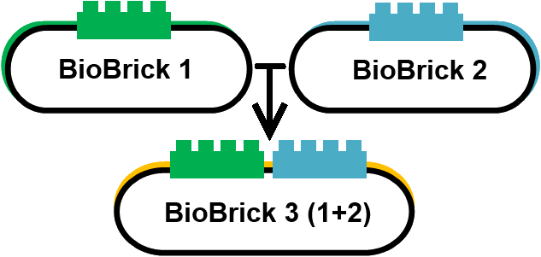
What is Synthetic Biology?
Synthetic biology is the combination of biology and other fields. For example, EE., CS., MSE., etc.
(a) The assembly of bio-bricks
Ref: http://2013.igem.org/Team:SDU-Denmark/Tour40

Slide 5

What is iGEM?
iGEM is the abbreviation of “International Genetically Engineering Machine” competition.
Teamwork:
Wet lab
Dry lab
Human practice
Ref: http://2018.igem.org/Main_Page

Slide 6
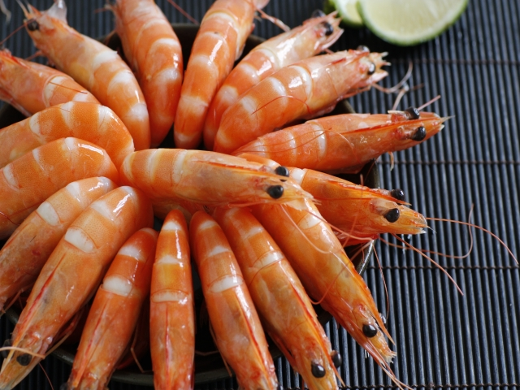
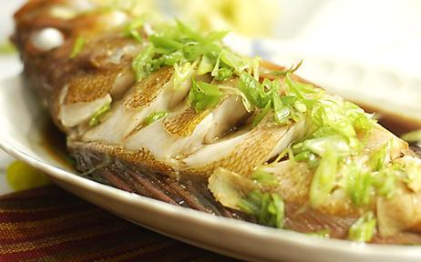

What is our Project?
Ref: http://www.enjoyfresh.com.tw/share_cont.php?N_Key=25&N_Class=27
https://www.douban.com/game/10773180/?dcs=sim
Icon made by Freepik from www.flaticon.com

Slide 7
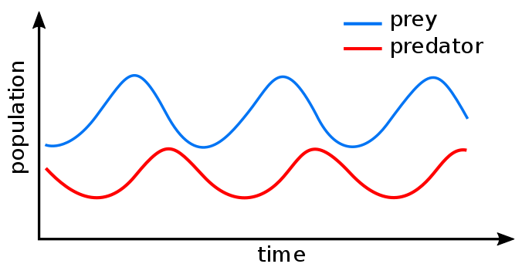
Our Solution
Based on the “prey-predator” model, we want to establish a feedback system to control the Vibrio population in a sustainable way.
(a) Prey-predator Model
Ref: https://en.wikipedia.org/wiki/Lotka%E2%80%93Volterra_equations

Slide 8
Outline
Introduction
Brief introduce synthetic biology and iGEM.
Introduction of our project.
Molecular biology lab
Introduction of pipette.
Introduction of cloning.
Plasmid extraction
Transformation
Colony PCR and electrophoresis

Slide 9
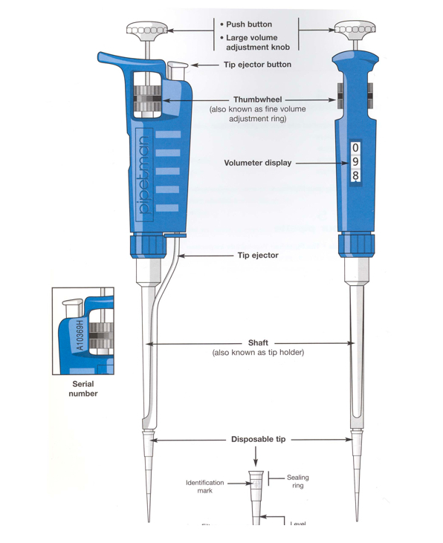
What is Pipette?
General types:
P1000 (100-1000 μL)
P200 (20-200 μL)
P20 (2-20 μL)
P10 (0.5-10 μL)
(a) Schematic of pipette
Ref: http://bio305lab.wikidot.com/appendix:pipettes

Slide 10
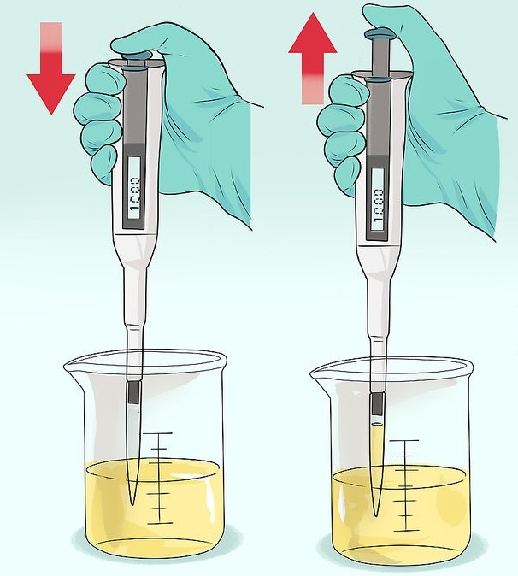
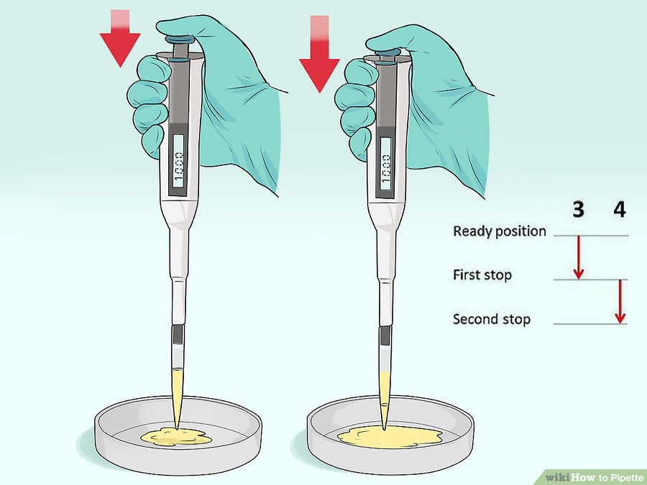
How to use Pipette?
(a) Usage of pipette
Ref: https://www.wikihow.com/Pipette

Slide 11
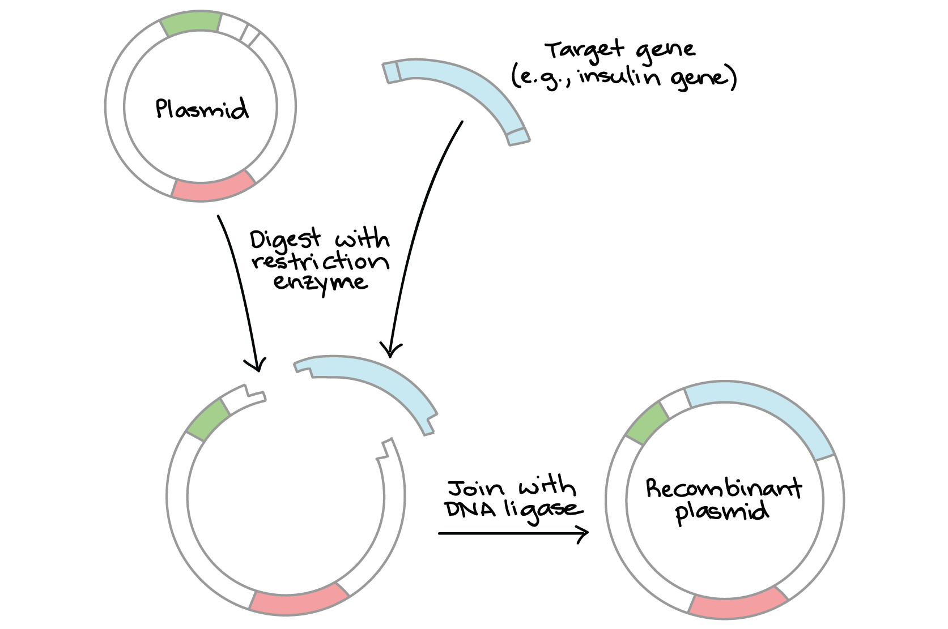
What is Cloning?
Cloning is the process of producing genetically identical individuals of an organism either naturally or artificially.
(a) Principle of cloning
Ref: https://en.wikipedia.org/wiki/Cloning
https://www.khanacademy.org/science/biology/biotech-dna-technology/dna-cloning-tutorial/a/overview-dna-cloning

Slide 12
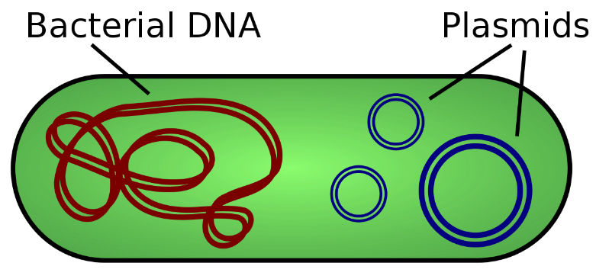
What is Plasmid?
A plasmid is a small DNA molecule within a cell that is physically separated from a chromosomal DNA and can replicate independently.
Characteristics:
Small
Selection marker
High copy number
Unique restriction enzyme site
(a) Schematic of plasmid DNA
Ref: https://en.wikipedia.org/wiki/Plasmid

Slide 13
Plasmid Extraction
Plasmid is useful for molecular biology research, e.g. protein purification, transfection, etc.
Methods:
Boiling method
Alkaline lysis

Slide 14
Alkaline Lysis
There are three main solutions used in this method.
Solutions:
Solution I (Re-suspension)
RNase
EDTA
glucose
Solution II (Lysis)
Sodium hydroxide (NaOH)
SDS
Solution III (Neutralization)
Potassium acetate (CH3COOK)
Acetic acid (CH3COOH)

Slide 15
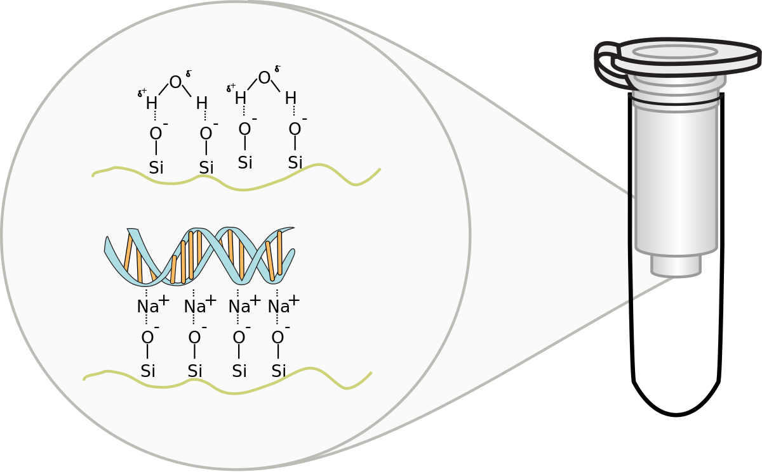
Silica in the spin column can bind our plasmid DNA specifically.
Membrane
(a) Schematic of DNA binding with spin column
Ref: https://en.wikipedia.org/wiki/Spin_column-based_nucleic_acid_purification

Slide 16
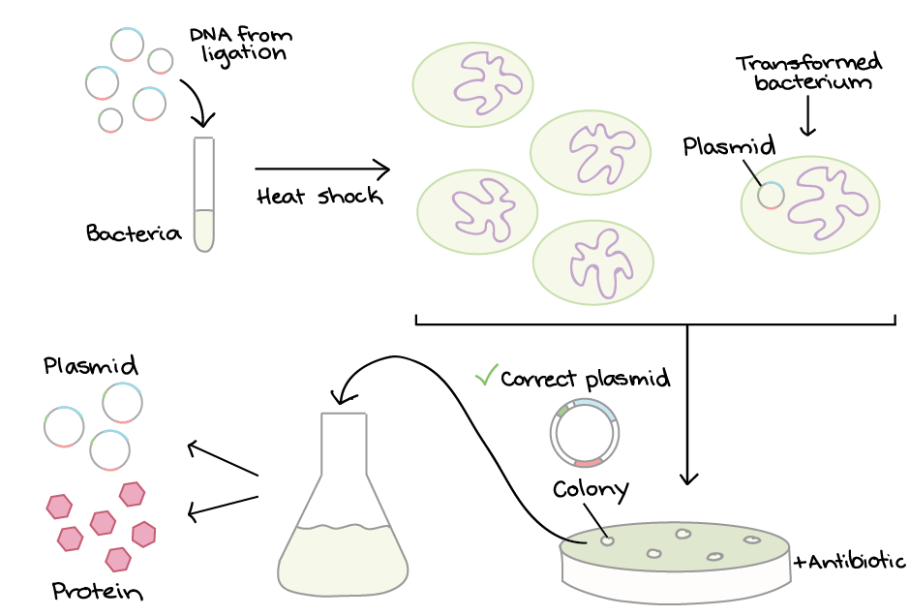
Transformation
A genetic alteration of bacteria resulting from the direct uptake of exogenous genetic material.
Competent cells
(a) Principle of transformation
Ref: https://www.khanacademy.org/science/biology/biotech-dna-technology/dna-cloning-tutorial/a/bacterial-transformation-selection
Notes:
Heat shock
Electroporation

Slide 17
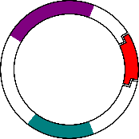



CaCl2
Ref: Icon made by Freepik from www.flaticon.com
https://commons.wikimedia.org/wiki/File:Plasmid_with_insert.svg
Icon made by Smashicons from www.flaticon.com

Slide 18
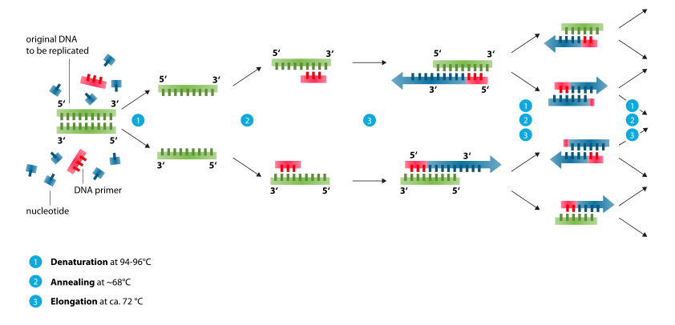
Polymerase Chain Reaction
PCR is a technique used in molecular biology to amplify a single copy or a few copies of a segment of DNA.
Ref: https://zh.wikipedia.org/wiki/%E8%81%9A%E5%90%88%E9%85%B6%E9%93%BE%E5%BC%8F%E5%8F%8D%E5%BA%94

Slide 19
Materials:
Primers
dNTP (dATP, dTTP, dCTP, dGTP)
DNA polymerase (Taq)
DNA template
Mg²⁺

Slide 20
Procedures:
Denaturation (94 - 98°C)
DNA melting. High temp. breaks the hydrogen bonds between bases.
Annealing (50 - 65°C)
It allows annealing of primers to each of the DNA templates.
Elongation (75 - 80°C)
DNA polymerase synthesizes a new DNA strand complementary to the original template.

